Slide 1
Designing Vehicle Routing Software
Talk at
  Spring School on Logistics and Distribution Management
École des HEC de Montréal, Canada
May 8-10, 2002
Geir Hasle
Research Director, Department of Optimization
SINTEF Applied Mathematics
Oslo, Norway
Geir.Hasle@math.sintef.no
http://www.math.sintef.no/
http://www.top.sintef.no/
Notes:
My background
PhD UiO in reactive factory scheduling
Stay at Robotics Institute CMU, Steve Smith, Mark Fox, Norman Sadeh
Worked with contract research at SINTEF/SI for > 20 years

Slide 2
Main messages
Motivation VRP
  exciting problem
  practical applications
  industrial relevance
  importance to society
  earn a living
Gap VRP research / technology / implementation
Potential for closing this gap
OR methods only one aspect
  business
  sw engineering
  human and organizational issues

Slide 3
Outline of talk
My background
General background
Design issues VRP sw
Examples
Future
Summary

Slide 4
SINTEF
The Foundation for Scientific and Industrial Research
at the Norwegian Institute of Technology
The vision:
Technology for a better society
Business concept:
SINTEF´s goal, in co-operation with NTNU and UiO, is to meet needs of the private and public sectors for research-based innovation and development
Locations:
The SINTEF Group has 1800 employees, 400 in Oslo and 1400 in Trondheim.

Slide 5






SINTEFs
council
SINTEFs board
President/
Vice-president
SINTEF Petroleum Research
SINTEF Applied Mathematics
SINTEF Civil and Environmental Engineering
MARINTEK
The Norwegian Marine Technology Research Institute
SINTEF Electronics and Cybernetics
SINTEF Energy Research
SINTEF Applied Chemistry
SINTEF Materials Technology
SINTEF Fisheries and Aquaculture
SINTEF Industrial Management
SINTEF Telecom and Informatics
SINTEF Unimed

Slide 6
SINTEF Group - Turnover 2000
Basic grant 3.3%
Strategic Programs, Research Council of Norway 4.5%
  Contracts 92.2%
  - Industry 50.1%
  - Public Sector 12.4%
  - International 14.5%
  - Research Council 9.0%
  - Others 6.2%

Slide 7
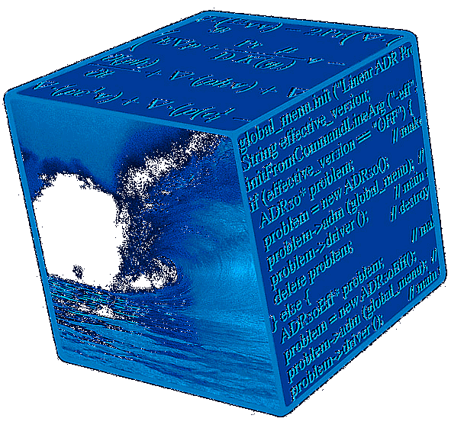
SINTEF Applied Mathematics http://www.math.sintef.no
A contract research institute in the SINTEF group
Modeling
Geometry
Simulation
Optimization

Slide 8
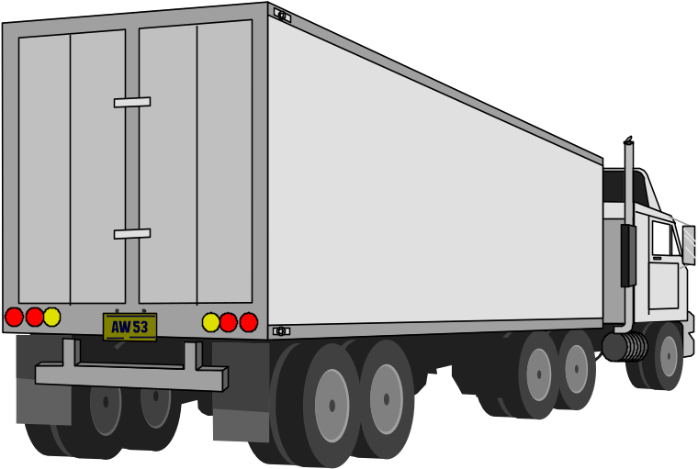
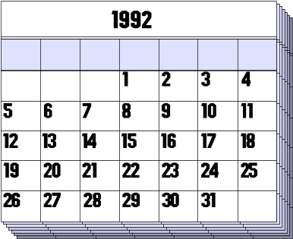

SINTEF Applied Mathematics
Department of Optimization
Focus:
Applied research
Planning
Decision Support
Application types:
Resource optimization
Design/configuration
Discrete
Basis:
Operations Research
Computing science
Software Engineering
Main business areas:
Transportation
Forestry
Oil & Gas
Health Sector
Approach:
Generic Tools
Reuse
Methodology

Slide 9
Outline of talk
My background
General background
Design issues
Examples
Summary

Slide 10
General background
State-of-the-art in VRP
Goods transportation
VRP Tools - status and needs
Mismatch

Slide 11
Transportation of goods in Norway (EU)
12.000 companies (EU 1/2 mill.)
Annual turnover € 4 billion (EU € 150 billion)
Many SMEs
36 % empty driving
Capacity utilization with load: 60 %
Logistics costs 12 % of product costs (EU 7 %)
EU: 13 million trucks, 800 billion ton-kilometers (1990)
Germany: freight income some € 30 billion (1990)
Probably a potential for improvement ...

Slide 12
Industrial use of VRP Tools
Swedish report* 1999 (commercial road transport)
Large end users, food & beverage
Generation of static routes
Vendors claim operational and dynamic tools
Very high potential for savings
* A. Henriksson, P. Liljevik: ”Dynamisk ruttplanlegging i verkligheten”
Minirapport MR 123, TFK - Institutet för transportforskning, Stockholm October 1999
Size of market for routing software?
1986: 13 packages
1997: 113 packages
# implementations grown
Cost savings increased

Slide 13
Trends in industry
focus on
  time
  cost
  utilization
  customer service
  lead time reduction
  reactivity
regulations, environmental concerns
e-commerce, home shopping, e-logistics
Increasing need for VRP Tools
Mismatch

Slide 14
Reasons for mismatch
Lack of awareness and education in industry
Lack of data and infrastructure
Price (SMEs)
Organizational problems, resistance
Practical constraints
  information availability
  physical movement
Tools not good enough
  functionality
  modelling power, representational adeqacy
  user friendliness
  integration
  performance
  legacy
  reactivity

Slide 15
Existing tools - keywords
Large variety: simple SPP, TSP, sophisticated VRP solvers
Focus: road transportation of goods, local distribution
Used for generation of static routes, built for operative planning
Packages, targeted at specific application areas
Primitive integration, but good import facilities
Inflexible and simple or heavy on consultancy
Windows-platform
Good user interfaces, map visualization, manual changes
Priced at USD 10.000 and above
Picture is changing, but
  modern VRP algorithms?
  real-time planning?
  multiple users?
  continuous optimization?

Slide 16
Some Vendors
Descartes Systems USA
Caps Logistics -> Baan USA
MicroAnalytics USA/GB
Roadnet Technologies (UPS) USA
RouteSmart USA
RouteLogic USA
i2 USA
ESRI USA
Kositzky and Associates USA
Manugistics USA
Carrier Logistics Inc USA
Insight Inc. USA/The Netherlands/GB
Caliper Corporation USA
Trapeze Software Group USA/Canada
Giro Canada
DPS International UK
Paragon Software Systems UK
Optrak (Andersen Consulting) UK
PTV D
Alfaplan D
PLS D
Prologos D
Diagma F
Ilog F
GreenTrip AS N
Typical claim 10 - 30% cost reductions - static route generation

Slide 17
General statements - Existing tools
Rich models
Good user interfaces
Geocoding, address handling
File handling, import/export
General VRP definition
Fairly simple VRP approaches
  Construction heuristics
  Improvement heuristics
  Intra-tour operators
R.W. Hall: Change of Direction. ORMS Today, February 2002

Slide 18
Trends and Developments
GIS - electronic road and address data
Positioning and Communication Technology
GPS, Galileo, Mobile Internet, GPRS
Integration technologies
Software Components
Better VRP Methods
Faster Computers
More robustness, user confidence, less interaction
ERP and GIS vendors interested
home shopping, e-logistics
.com death, slow IT market
Focus on ROI

Slide 19
VRP Tools in Operation in Norway
Food and beverage:
  Coca-Cola
  NKL
Taxi companies
Security: Falken
Road rescue: NAS
Transportation service:
  DFDS Tollpost-Globe
  Linjegods
Norwegian Postal Services
Process industries: Hydro Agri
No dynamic routing

Slide 20
Dynamic, real-time routing - Success stories?
Paragon - Tesco
  “… Home shoppers simply log onto the dedicated area of Tesco's website, select their purchases and identify a two hour time window for delivery to an address of their choosing... ”
Truckstops
  “… In some UK applications it is even used to recalculate routes during the day, modifying its original calculations to take account of new requirements and reflecting data transmitted back from vehicles by radio … ”

Slide 21
Goal - VRP Technology
real benefits for end users - logistical performance
solve right problem
plan quality vs. response time
user interaction, user-friendliness
configurability
reactivity
price
market
OR and VRP methods only part of the answer

Slide 22
Challenges - VRP Tools
Functionality
Modelling
  constraints
  criteria
  uncertainty
  dynamics
  supply-chain coordination
Adaptability
Power: speed vs. quality
Very large-size problems
User Interface, plan vizualisation
Mixed initiative problem solving
Integration
Support etc.
OR / VRP algorithms only part of the answer

Slide 23
Outline of talk
My background
General background
Design issues
Examples
Future
Summary

Slide 24
Actors and systems
VRP software developers
  end users
  consulting companies
  routing sw vendors
  contract research companies
  research labs
Bespoke systems
Generic systems
You want to establish a new company

Slide 25
Business/Organizational Issues (1)
Business idea
  technology driven
  market driven
“Product”
  services
  “transportal” web
  package, turnkey solution
  sw component
Funding
Notes:
Before you even think about starting development

Slide 26
Business/Organizational Issues (2)
Business plan
  market and competitor analysis
  SWOT
  market segment
  market strategy
Alliances/partners
  component vendors
  integrators
  distributors
Notes:
Before you even think about starting development

Slide 27
Business/Organizational Issues (3)
Marketing
Sales
Support
Development
Quality Systems
Administration
Research
Offices
Emplyees
Customers
Education of market
Organizational issues at customer
Notes:
Before you even think about starting development

Slide 28
Issues - Generic Routing Software
Tension
  market size’
  development time and effort
  performance
Pricing
  legacy from competitors
  performance guarantees
  value based
  quantification and comparison
Availability, quality, level of information and infrastructure
  electronic road and address data (GIS)
  maps for visualization
  order information
  fleet information

Slide 29
Issues - Generic Routing Software
Performance and scalability
hw/sw platform
  today
  tomorrow
Programming language
  development efficiency
  speed performance
  industrial acceptance
External components
Development
  reactivity
  vulnerability
Re-use of knowledge and software
Innovation
sw engineering

Slide 30
Software Development Process
user requirements
specifications
design
coding
unit testing
integration
integration testing
acceptance
support and maintenance
additional requirements
reconfiguration
new development
Errors in early stages are costly
Good documentation is crucial - and time consuming
SW reactivity is an important competitive factor
Notes:
TOP-down vs. bottom up
Depending on your business idea
Both perspectives interesting anyway
Testing difficult; good test data
Test data

Slide 31
Development - Bespoke System (1)
Planning and estimation - learn
Understanding the end user
  which user?
  which objective?
  Which constraints?
  tacit knowledge
  repercussions of choice?
Specifications are critical
  contract
  performance guarantees
  objective function
Design
  conceptual model
  choice of architecture
  choice of platform
Notes:
TOP-down vs. bottom up
Depending on your business idea
Both perspectives interesting anyway
Testing difficult; good test data
Test data

Slide 32
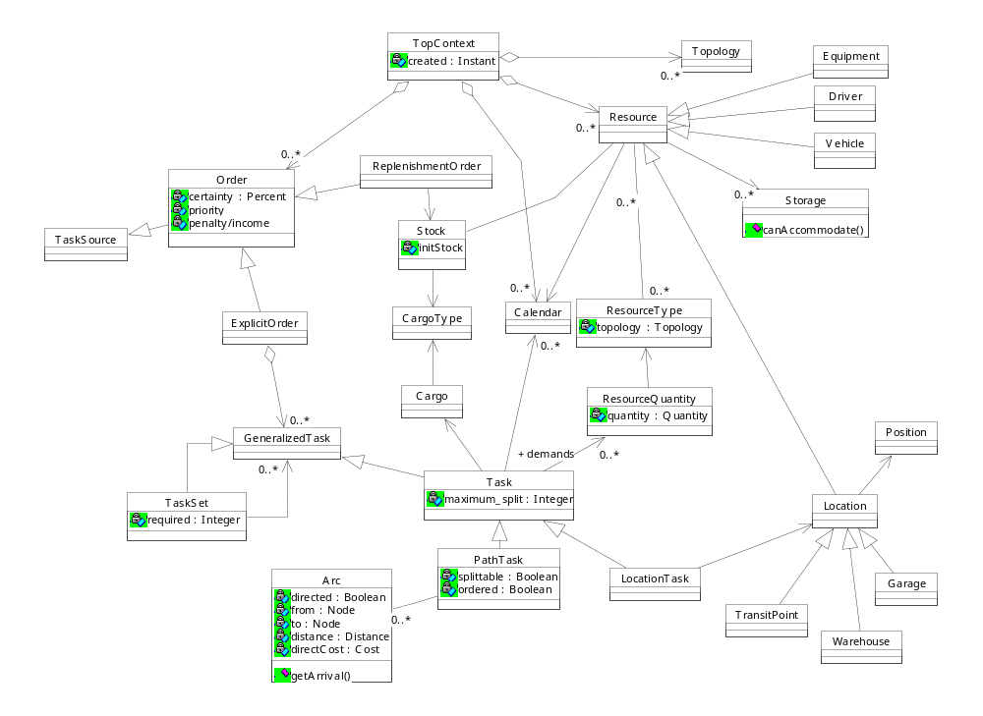
Conceptual Modelling

Slide 33
Development - Bespoke System (2)
Algorithmic development
  time consuming
  analysis
  repertoire
  library
  methodology
Testing
  from difficult - to nightmare
  test data - inconsistent
  testbench
Acceptance
  test not clearly defined
  acceptance criteria not clearly defined
  end user dislikes plans
  the VRP Horror Show
  lawyers
Notes:
TOP-down vs. bottom up
Depending on your business idea
Both perspectives interesting anyway
Testing difficult; good test data
Test data

Slide 34
Remedies
Contract
Communication
Documentation
Client responsible for every decision
Notes:
TOP-down vs. bottom up
Depending on your business idea
Both perspectives interesting anyway
Testing difficult; good test data
Test data

Slide 35
Software Engineering Issues
There are choices in software design
Depending on
  product type
  range of applications
Research prototypes vs. commercial sw products
Tension between
  sw engineering requirements
  performance

Slide 36
Software design parameters
Robustness, stability, reliability
Maintainability
Extendability
Portability
Reactivity
Object-orientation
  design
  coding

Slide 37
Design parameters - methods/algorithms
Robustness
  assumptions
  performance over instances
Scalability
Anytime
Mixed-initiative
Simplicity
Performance
Choices depending on product type

Slide 38
Advice on algorithmic development
Use a tool / library when appropriate
Focus on simplicity and robustness
Try alternatives in right sequence
Use test bench
Keep and manage test cases and results
Limit parameter tuning
Avoid the quest for perfection
  fulfil VRP performance requirements
  competition: human planners
  general tools: better than competition
  performance optimization
Enhance library
The above may point to reasons for mismatch

Slide 39
From problem to solution (1)
Problem->Model->Modelling Language->Solver->Solutions
Mathematical Programming
  modelling languages / general LP / MIP solvers (AMPL / CPLEX)
  solver is black box with controls
Logic programming (Prolog)
  declarative programming language
  built-in resolution
Constraint Logic Programming (eCLiPSe, CHIP)
Constraint Programming (Solver)

Slide 40
From problem to solution (2)
Problem->Model -> Modelling Language -> Solver->Solutions
Heuristic/non-systematic search: research issue
“No free lunch” theorem: tailoring of algorithms is needed
Callable packages / numerical libraries
Enhancements to constraint programming languages
Optimization software libraries (source code)
  conceptual model
  object-oriented framework
  inheritance and specialization of objects
  inheritance and specialization of algorithms not so easy
Control architectures, Agent architectures, Parallelism
S. Voß, D. Woodruff: Optimization Sw Class Libraries, Kluwer 2002

Slide 41
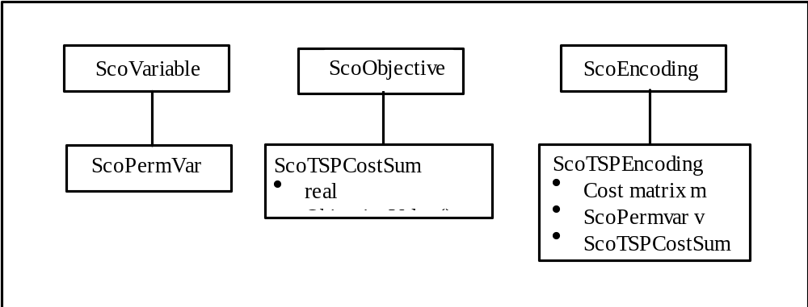
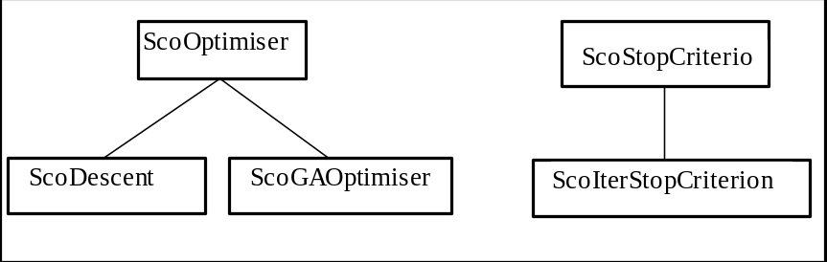
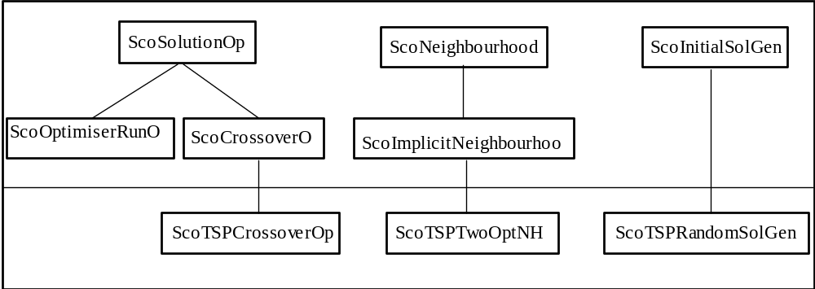
Example of Optimization Library
Modelling framework
  Optimization problems
  CSP
Problem encoding
  Variables
  Constraints
  Objective(s)
Solvers
  IIT
  CSP / COP

Slide 42
SCOOP Concepts
Problem definition:
Variables
Objective(s)
Constraints
ScoEncoding:
ScoVariable
ScoObjective
ScoConstraint
….and subclasses
Local search:
ScoOptimiser
Create initial solution(s)
ScoInitalSolGen
Until Stop Criterion:
  Find neighbors
ScoOptimiser::optimize()
ScoNeighbourhoodSelector::selectNeighbourhood()
  Evaluate neighbors
    Constraints
    Objective(s)
ScoNeighbourhood::nextNeighbour()
ScoSolution(Set)Evaluator::value(neighbor)
  Move to selected
  neighbor
ScoNeighbourhood::moveToSavedNeighbour()

Slide 43
Outline of talk
My background
General background
Design issues
Examples
Future
Summary

Slide 44
VRP at SAM - Examples
SPIDER - Dynamic dispatching system - VRP Solver
GreenTrip
HAMMER - ship scheduling, deterministic inventory routing
Integrated bus rotation and crew scheduling
Newspaper distribution - PDAs
TOP

Slide 45
GreenTrip European Project
Esprit 20603, January 96-March 99, > 40 person-years
Consortium
  Tollpost-Globe (N)
  Pirelli (I)
  Ilog (F)
  University of Strathclyde (GB)
  SINTEF (N)
RTD in
  methods
  algorithms
  generic sw for optimized transportation management
Demonstration

Slide 46
The GreenTrip Consortium
Tollpost-
Globe
Pirelli
SINTEF
ILOG
UoS
Notes:
25

Slide 47
Goals – GreenTrip project
Produce cost-effective tool to optimize routing of vehicles
generic
multiple business constraints
efficient (re)configuration
integrate easily in existing IT infrastructure
Notes:
23

Slide 48
GreenTrip - Technical Approach
Applications Modelling
Automated Systems (Re)Configuration
OO Programming
Components, standard interfaces
Local Search and Meta-Heuristics
Constraint Propagation
Notes:
24

Slide 49

CASE : TOLLPOST-GLOBE
Regular and non-regular customers
Some 100.000 customers in the Oslo region
Deliveries : 2.400
Pick up orders : 600
Time windows - Customer service
No two days equal
Some 100 vehicles
Non-homogeneous fleet (size, volume, equipment)
Depot with automatic sorting / registration
Notes:
8

Slide 50
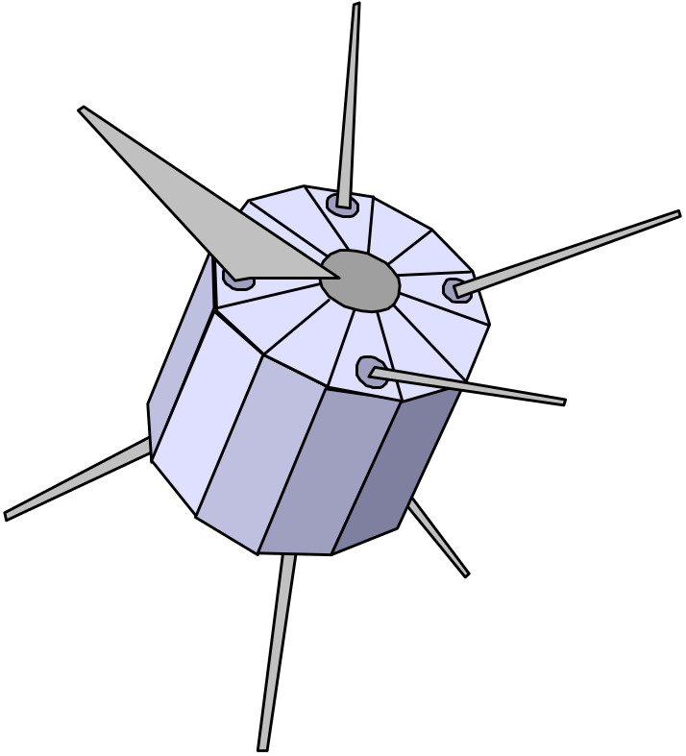
CASE : TOLLPOST-GLOBE
Electronic road and address data available via the GIS Transportation Demonstrator
Mobile communication installed in 15 vehicles
GPS installed in 5 vehicles
Goal: dynamic fleet management system
Notes:
9

Slide 51
The Pirelli (Cables) Case
Logistics network simulator
Assessment of logistical performance
Detailed analysis of alternative structural changes
Scenarios 6 months operation, 10.000 orders
Notes:
13

Slide 52

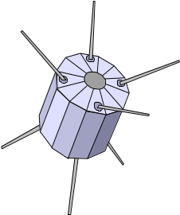



GreenTrip - GGT Systems Architecture
Application-
Modelling
Application Server
Application
Model
VRP Solver
GIS
Road data
Legacy Systems

Slide 53
The VRP Solver - Objects
Plans
Locations
Visits
Vehicles
Routes
Dimensions
Constraints

Slide 54
VRP Solver - Algorithms
Construction
  Savings
  Sweep
  Nearest Insertion
Improvement, move operators
  2-opt, Or-opt
  Relocate
  Exchange
  Cross

Slide 55
VRP Solver - Search Control
Basic heuristic
  Greedy Search (First Improvement)
  Steepest Descent (Best Improvement)
Meta-heuristics
  Tabu Search
  Guided Local Search
  Guided Tabu Search
Large Neighbourhood Search

Slide 56
GreenTrip - Results
Several “Best-until-now” results on Solomon cases
  #vehicles
  waiting time
Industrial Test Cases - demanding
Publications
  some 20 scientific papers
  technical reports - “VRP Solving and IIT Survey”
  a large number of talks - educating the market

Slide 57
GreenTrip Dissemination
Kilby, Prosser, Shaw: Guided Local Search for the VRP, Proc. MIC 97
De Backer, Furnon: “Metaheuristics in Constraint Programming: Experiments with Tabu Search on the VRP, Proc. MIC 97
De Backer, Furnon, Kilby, Prosser, Shaw: Local Search in Constraint Programming: Applications to vehicle routing problems, CP 97 Scheduling Workshop
Hasle: GreenTrip - the Development of a Generic Toolkit for Vehicle Routing, NOAS 97
De Backer, Furnon: Solving vehicle routing problems with Side Constraints Using Constraint Programming, INFORMS 97
Hasle: Transportation Management in Distributed Enterprises. Invited talk at the ESPRIT Copernicus Symposium, Wroclaw, Poland, April 23-24 1998.
De Backer, Furnon: Modelling pickup and delivery problems in constraint programming, INFORMS 98
Hasle: Overview of the GreenTrip Project Results. Talk at GreenTrip Open Event, Amsterdam, 1999
Hasle: GreenTrip On The Market - SINTEF Exploitation. GreenTrip Open Event, Amsterdam,1999.
Bouzoubaa, Hasle, Kloster, Prosser: The GGT: a Generic Toolkit for VRP Applications and its Modelling Capabilities, Proc. PACLP 99
Hasle: Efficient and Environment-Friendly Transportation Logistics in the E-Commerce Era. Invited Talk at e-Mobility 2001.
http://www.GreenTrip.sintef.no/

Slide 58
GreenTrip Papers
De Backer, Furnon, Kilby, Prosser, Shaw: “Solving vehicle routing problems with constraint programming and metaheuristics”, Journal of Heuristics, Special Issue on CP
Kilby, Prosser, Shaw: “A comparison of traditional and constraint-based heuristic methods on vehicle routing problems with side constraints”, Constraints, April 98
De Backer, Furnon: “Local Search in Constraint Programming”, in META-HEURISTICS: Advances and Trends in Local Search Paradigms for Optimization (Voss, Martello, Osman, Roucairol, 1999)
Kilby, Prosser, Shaw: “Guided Local Search for the Vehicle Routing problem with Time Windows”, in META-HEURISTICS: Advances and Trends in Local Search Paradigms for Optimization (Voss, Martello, Osman, Roucairol, 1999)
Hasle: Transportation Management in Distributed Enterprises. Human Systems Management 18 (1999).
Hasle: Transportation Management in Distributed Enterprises. In Garello, Skordas (eds): Distributed Enterprise, Intelligent Automation and Industrial Benchmarking - putting Information and Communication Technologies into Practice.
Kilby, Prosser, Shaw: “Dynamic VRPs: A Study of Scenarios”
http://www.GreenTrip.sintef.no/

Slide 59
Commercialization from GreenTrip
Ilog Dispatcher
SPIDER Planner / Guider
New Company GreenTrip AS
Other Norwegian sw vendors

Slide 60
SPIDER
VRP Solver
  C++ program library
  COMponent
SPIDER Planner / Guider
Adaptable to wide variety of applications
Distribution through sw vendors
SPIDER Designer from GreenTrip AS

Slide 61
SPIDER Model
Concepts / objects
Objective components, cost structure
Constraints
Types of order
  pickups
  deliveries
  direct
  single visit
Object-oriented design and implementation
Based on underlying generic optimization library SCOOP

Slide 62
SPIDER VRP Approach
Three phases
  Construction
  Tour depletion
  Improvement
Well-known constructors and local search operators
Modified to cope with generalized model
Guided Local Search metaheuristic

Slide 63
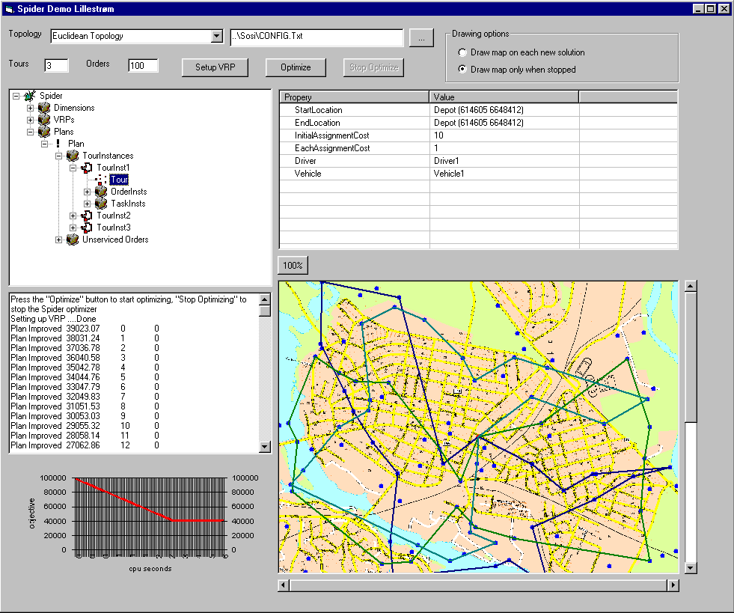

Slide 64
Outline
My background
General background
Design issues
Examples
Future
Summary

Slide 65
Future VRP technology
GIS vendors
ERP vendors
ASP solutions, thin clients, Internet, www
Better tools for strategic/tactical planning
Supply-chain coordination, integrated solutions
Dynamic, real time fleet management

Slide 66
Dynamic Fleet Management - Prerequisites
ICT infrastructure
  order data
  fleet data, positions, status
access to high quality traffic data
  speed predictions
  “organic” electronic road network
Better understanding of
  routing policies
  reactive planning
  proactive, stochastic planning
Better VRP algorithms

Slide 67
Issues in VRP research
Rich models
  type of service
  tope of network
  uncertainty
  dynamics
  idiosyncratic constraints
  multiple criteria
Reactive and proactive planning
  disruption
  slack
  policies
Large problem instances
Over-constrained problems
Plan quality vs. response time performance
Human and organizational issues

Slide 68
Research Agenda: VRP
Cooperating VRP solvers, hybrid methods
Mapping problem type - algorithm
Decomposition
Control Architectures
Combining exact and heuristic methods
Multi-criteria problems

Slide 69
The TOP Program 2001-2004
Applied Research in Transportation Optimization
Strategic Research Program funded by Research Council of Norway
National and international networking
Network Design, VRP, SPP
Rich Models
Goals
  Methodological Improvements
  Solvers
  Demonstration
  Iteration
http://www.top.sintef.no/

Slide 70
TOP Workplan
State-of-the-art
  Literature survey - rich models
  Technical Report
  Bibliography
Requirements
  Experience from Earlier Work
  Existing Solvers
Design
  Conceptual Model
  Architecture
  Software
Implementation of Solvers
Methodological Development

Slide 71
TOP Papers
Bräysy, O. (2001) Fast Local Searches for the Vehicle Routing Problem with Time Windows. Working Paper, SINTEF Applied Mathematics, Department of Optimization, Norway.
Bräysy, O. (2001) A Reactive Variable Neighborhood Search Algorithm for the Vehicle Routing Problem with Time Windows. To be published in INFORMS Journal on Computing.
Berger, J., M. Barkaoui and O. Bräysy (2001) A Parallel Hybrid Genetic Algorithm for the Vehicle Routing Problem with Time Windows. Working paper, Defense Research Establishment Valcartier, Canada, 2001.
Information on http://www.top.sintef.no/

Slide 72
TOP Technical Reports
O. Bräysy and M. Gendreau (2001) Tabu Search Heuristics for the Vehicle Routing Problem with Time Windows. Internal Report STF42 A01022, SINTEF Applied Mathematics, Department of Optimization, Oslo, Norway.
O. Bräysy and M. Gendreau (2001) Genetic Algorithms for the Vehicle Routing Problem with Time Windows. Internal Report STF42 A01021, SINTEF Applied Mathematics, Department of Optimization, Oslo, Norway.
O. Bräysy and M. Gendreau (2001) Route Construction and Local Search Algorithms for the Vehicle Routing Problem with Time Windows. Internal Report STF42 A01024 SINTEF Applied Mathematics, Department of Optimization, Oslo, Norway.
O. Bräysy and M. Gendreau (2001) Metaheuristics for the Vehicle Routing Problem with Time Windows. Internal Report STF42 A01025, SINTEF Applied Mathematics, Department of Optimization, Oslo, Norway.
O. Bräysy, M. Gendreau, G. Hasle, A. Løkketangen A Survey of Rich Vehicle Routing Models and Heuristic Solution Techniques, Draft Technical Report
Information on http://www.top.sintef.no/

Slide 73
Summary
VRP increasingly important
Gap between VRP research / technology / implementation
Potential for narrowing the gap
Design of routing software is hard
Many conflicting concerns
VRP methods only one aspect
Good luck!

Slide 74
Designing Vehicle Routing Software
Talk at
  Spring School on Logistics and Distribution Management
École des HEC de Montréal, Canada
May 8-10, 2002
Geir Hasle
Research Director, Department of Optimization
SINTEF Applied Mathematics
Oslo, Norway
Geir.Hasle@math.sintef.no
http://www.math.sintef.no/
http://www.top.sintef.no/
Notes:
My background
PhD UiO in reactive factory scheduling
Stay at Robotics Institute CMU, Steve Smith, Mark Fox, Norman Sadeh
Worked with contract research at SINTEF/SI for > 20 years

Slide 75
Vessel Routing - Ammonia
Large company
Producer - Consumer Harbours (25)
Fleet (10)
Strong Inventory Constraints
External Trading
Feasible solution
Approach taken: Heuristic Sequencing + LP

Slide 76
HAMMER Problem
Producing harbours
Quantity
Time-window
Consuming
harbours
Fleet of vessels
Harbours with stock
inventory
External orders
(laycans)
Find the routing plan with the lowest cost
so that inventory limits are not exceeded
and all external orders included.

Slide 77
Combinatorial solution
Vessel View:
Harbour View:
2
3
6
H1:
H2:
1
4
H3:
H4:
7
H5:
H6:
5
H7:
Site
Route for Vessel 1
Vessel 1
Route for Vessel 2
Vessel 2
Vessel View:
Which harbours, and in which sequence, each vessel will visit.
Harbour View:
Which vessels, and in which sequence, will call at each harbour.

Slide 78
HAMMER - Linear solution
Vessel view:
Harbour view:
Load
max
min
Time
Call
Stock
Time

Slide 79
HAMMER - System overview
Problem data
Initial
solver
Iterative
improver
Combinatorial solution
Feasibility check
Feasible solution
Greedy Propagator
Update
LP solver

Slide 80
Working with the system
Initialization of the problem
  Harbours, ships, laycans and planning parameters
Schedule generation
  Initial solver - from scratch or existing
  Iterative improvement
Analysis and user interaction
  plan statistics - slack, unserviced
  manually change plan
    Lock ship, harbour or time period
Objective function and plan acceptance
Flatberg, Haavardtun, Kloster, Løkketangen. (2000): Combining exact and Heuristic methods for solving a Vessel Routing Problem with inventory constraints and time windows. Ricerca Operativa, special issue on combined constraint programming and OR techniques

Slide 81
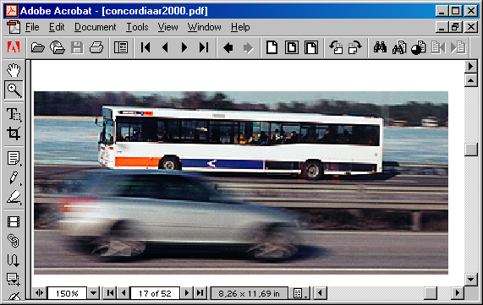
Integrated Shift- and Vehicle Optimisation for Concordia Bus

Slide 82
The system
Rich model, e.g.,
  time varying deadhead and walking/transport topology
  constraints: locks, pauses, breaks, sign times, preparation times, relief restrictions, parking capacities, bus guarding, layover times, safety margins, service requirements, etc.
  currently supports 26 “real” or “soft” cost factors
  selection sets on drivers and vehicles
Algorithm for pre-processing of the topology
Constructive algorithm for generation of initial plan
Local search algorithm for optimisation
  not relying on a skilled user to achieve effective optimisation
Repair algorithm for modifying plans to “special days”

Slide 83
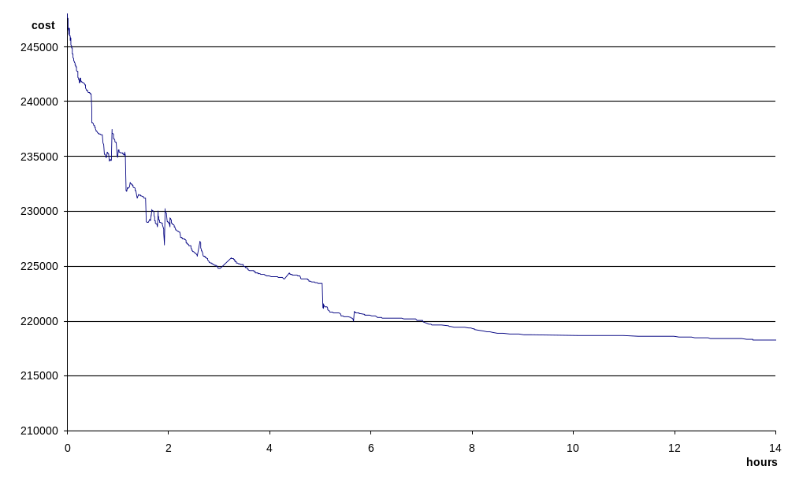
Typical optimisation run

Slide 84
Results (December 2001)
  System developed with rich constraint- and cost model
  New schedules implemented in 3 regions (3 more regions within the next 2 months)
  2-5 % reduction of direct costs (SEK 2-3 mill per region) vs. schedules developed by experienced planners or experienced users of Hastus
  20-30% reduction of “soft costs” (trying to meet what the drivers themselves defines as “good” shifts)

Slide 85
Ideas (1)
Historical background
  Development of routing sw
  From recent textbook
  Surveys
  Size of market
  Trends
Identify the “world” Universe of discourse
  Users requirements
  Strategical, Tactical, Operational, Dynamic
  Multi-modality
  SCM
  Functionality
  Stochastic / Dynamic
  Conceptual modelling
Notes:
Geir Hasle, SINTEF Applied Mathematics: Designing Vehicle Routing Software
Fleet management tools with route optimization functionality have been
available on the market for many years. The savings potential is high. Yet,
such tools have been deployed in industry only to a rather limited degree.
There are a number of reasons. Most of them are not touched upon in the
scientific VRP literature. Designing vehicle routing software is a difficult
task. One needs to balance a number of partially conflicting concerns. To
address a broad application market, the underlying VRP model must be rich
and flexible. The corresponding resolution algorithms need to be robust and
scalable. The code should be efficient, but also readable, extendible, and
maintainable. Excellent user interfaces, including several types of plan
visualizers and facilities for mixed-initiative planning, are crucial.
Narrow, configurable, and general interfaces to systems for order handling,
mobile communication, and electronic road and address data are vital
components. Effective and efficient mechanisms for configuring and
re-configuring the tool to a given application may significantly reduce
implementation costs. This talk will address and illustrate several issues
related with the design of vehicle routing software.

Slide 86
Ideas (2)
Important concerns algos
  Robustness
  Anytime
  Scalability
  assumptions
User Interfaces
Mixed Initiative
SW engineering concerns
  Extendability
  Maintainability
  Lucidity
  Reliability
  Portability
  MTBF
Recent literature
Academic network
Interfaces
  HCI
  Legacy
  Communication
  GIS
  Maps
  Addresses
  Electronic road network
Uncertainty
Examples of weird requirements from BSB
Examples of weird road/address data
lot of code for trivial matters
  data management and shuffing
  address matching
  geocoding
tension between
  oo implementation and performance
  clean implementation and flexibility
  OO design important anyway

Slide 87
Ideas (3)
users req’s
  difficulties
  practical concerns
  objectives
  richness / idealization
  constraints
  legislation
  ferries etc.
  toll costs
  uncertainty
  dynamics
algorithmic issues / performance
  robustness
  performance
  scalability
  how to compare before / after
SE issues
  lucidity / simplicity
  robustness /MTBF
  extendability
  constraint programming
  testing difficult
differences research engine / commercial engine
  model
  algorithms / implementation
  SE issues
OR uses math modelling - for what?
ORMS Today Survey

Slide 88
Strange requirements and stories
borettslag-problemet
veikryssing store veier
køer på depot
ordretyper extended PDP single visits
veinett
  adressevasking
  snap
  enveikjøring
fysisk godshåndtering terminal
vanskelig testing / skjønner ikke hvorfor
jevn fordeling på tilgjengelig flåte
20% Oslo addresses at mental hospital
islands in road network
difficult testing
explanation mechanisms needed
newspaper routing
Notes:
Geir Hasle, SINTEF Applied Mathematics: Designing Vehicle Routing Software
Fleet management tools with route optimization functionality have been
available on the market for many years. The savings potential is high. Yet,
such tools have been deployed in industry only to a rather limited degree.
There are a number of reasons. Most of them are not touched upon in the
scientific VRP literature. Designing vehicle routing software is a difficult
task. One needs to balance a number of partially conflicting concerns. To
address a broad application market, the underlying VRP model must be rich
and flexible. The corresponding resolution algorithms need to be robust and
scalable. The code should be efficient, but also readable, extendible, and
maintainable. Excellent user interfaces, including several types of plan
visualizers and facilities for mixed-initiative planning, are crucial.
Narrow, configurable, and general interfaces to systems for order handling,
mobile communication, and electronic road and address data are vital
components. Effective and efficient mechanisms for configuring and
re-configuring the tool to a given application may significantly reduce
implementation costs. This talk will address and illustrate several issues
related with the design of vehicle routing software.

Slide 89
Construction phase
Several construction heuristics
  Best Insertion (Relocate from Unserved)
  Clarke & Wright savings
  Solomon I1
  Nearest Insertion
  ...
Modified to general model

Slide 90
Tour removal phase
mTSP intra-tour operators
VNS/VND using
  tour removal
  intra-tour operators
iterate until local optimum

Slide 91
Improvement phase
variable neighborhood search / descent
  relocate
  cross
  exchange
  2-opt, 3-opt, OR-opt
  tour depletion
Guided Local Search

